Slide 1
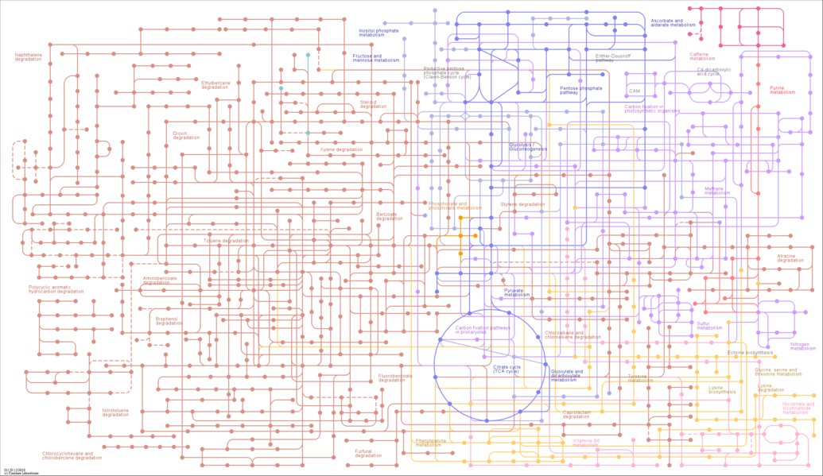


Mapping Metabolic Networks in Complex Biological Systems using Carbon-13 isotopes
Thomas D. Horvath*, Shai Dagan, Di Du, Lin Tan, Leona Martin, Phil L. Lorenzi, David H. Hawke, and Patricia Y. Scaraffia
TCMC colleagues: Sibel Ak, Numan Oezguen, Jennifer Spinler, Tor Savidge, and Anthony Haag
NIH Systems Biology Modeling Working Group meeting
May 28th, 2019
Background image: KEGG database: Microbial metabolism in diverse environments – Reference Pathway
Notes:
In this talk, I will:
1.) Provide some relevant background information
2.) describe some of the more relevant aspects of experimental design
3.) introduce several mass spec platforms, and describe how these LC/MS measurements are made
4.) and finally, I will describe a research application that utilized the isotope tracing techniques described.

Slide 2
Overview
What are Stable-Label Isotope Tracers?
Relevant atoms and their isotopes
Chemical versus Mass Spec perspectives
Isotopically-labeled substrates
Isotopically-labeled background
Practical Considerations
How are isotopically labeled compounds measured?
Selected Research application
Notes:
Part 1 of this presentation will serve as a reminder of the background information necessary to begin the discussion on LC-MS based isotope tracing studies.

Slide 3
I. relevant atoms and their isotopes
 | element | Atomic number (Z) | Atomic number (Z) | Neutron number (N) |  |  | Mass Number (A) | Symbol | Atomic mass (u) | Natural Abundance (%)
 | hydrogen | 1 | 1 | 0 |  |  | 1 | ¹H | 1.007825 | 99.9885
 | (deuterium) | 1 | 1 | 1 |  |  | 2 | ²H | 2.014102 | 0.0115
 | (tritium) | 1 | 1 | 2 |  |  | 3 | ³H | 3.016049 | *
 | carbon | 6 | 6 | 6 |  |  | 12 | ¹²C | 12.000000 | 98.93
 |  | 6 | 6 | 7 |  |  | 13 | ¹³C | 13.003355 | 1.07
 |  | 6 | 6 | 8 |  |  | 14 | ¹⁴C | 14.003242 | *
 | nitrogen | 7 | 7 | 7 |  |  | 14 | ¹⁴N | 14.003074 | 99.632
 |  | 7 | 7 | 8 |  |  | 15 | ¹⁵N | 15.000109 | 0.368
 | oxygen | 8 | 8 | 8 |  |  | 16 | ¹⁶O | 15.994915 | 99.757
 |  | 8 | 8 | 9 |  |  | 17 | ¹⁷O | 16.999132 | 0.038
 |  | 8 | 8 | 10 |  |  | 18 | ¹⁸O | 17.999160 | 0.205
 | *not present in nature, or a meaningful natural abundance cannot be given
Table of Isotopic Masses and Natural Abundances
http://www.chem.ualberta.ca/~massspec/atomic_mass_abund.pdf
Notes:
Note that tritium is a radioactive nuclide, thus, the red text designation.

Slide 4
I. a “matter” of perspective
Chemistry perspective
Chemical formula: C₃H₇N₁O₂
Average M_{m}: 89.094 g/mol
Mass spectrometry perspective
Monoisotopic chemical formula: [¹²C]₃[¹H]₇[¹⁴N]₁[¹⁶O]₂
Monoisotopic mass : 89.04767 Da*
[M+H]⁺: m/z 90.05495*
[M-H]⁻: m/z 88.04039*
*https://mods.rna.albany.edu/masspec/MoIE
Notes:
Now, the discussion will transition to isotopically-labeled metabolic substrates and products.
Chemistry perspective:
We are all familiar working with chemical formulas and average molar masses of compounds.
So, the reported molar mass of a compound is a weighted average of the distribution of all naturally occurring isotope-labeled species for that compound.
Press the down arrow
Mass Spectrometry perspective:
Mass spectrometers do not measure average masses, so the isotopically-labeled atom content of a compound has to be taken into account.
The monoisotopic chemical formula is specific to a chemical structure that has all of the atoms in the molecule in the same, most-abundant isotopic state
The monoisotopic exact mass is the mass of the compound for a specific monoisotopic chemical formula.
The mass of the protonated and deprotonated molecular ions of alanine are presented here to 5 decimal places of precision.

Slide 5
I. isotopically-labeled background
Monoisotopic Ala
Di-isotopically labeled Ala
[¹³C₀]-Ala
Di & Poly-isotopically labeled Ala
[3-¹³C₁]-Ala
[2a-¹⁵N₁]-Ala
[2b-²H₁]-Ala
[1,3-¹³C₂]-Ala
[3-¹³C₁, 2b-²H₁]-Ala
[1a-¹⁸O]-Ala
[3-¹³C₁, 2a-¹⁵N₁]-Ala
[2a,a, 2b-²H₂]-Ala
Isotope labeled atoms are designated with red text
Positional numbers of atoms are designated with blue text
Notes:
Once we realized the complexity of the problem, my collaborator asked the question “How many isotope-labeled species comprise the naturally occurring background for each metabolite??”
I have created the following graphics to illustrate the complexity of this question using Alanine as an example
Press the down arrow key
As you can see from the next graphic, the situation gets complicated for M+1 protonated molecular ion of Alanine
Press the down arrow key
Now the situation gets very interesting when you consider the distribution of isotopically-labeled species for the M+2 protonated molecular ion of Alaine.

Slide 6
I. Background of isotopically labeled alanine species
 | protonated molecular ion | naming convention | Di- & Poly-isotopically labeled species | incidence
 | [(M+2)+H]⁺ | [x,y-¹³C₂]-Ala | [¹³C]₂[¹²C]₁[¹H]₈[¹⁴N]₁[¹⁶O]₂ | 3
 |  | [x-¹³C₁, y-²H₁]-Ala | [¹³C]₁[¹²C]₂[²H]₁[¹H]₇[¹⁴N]₁[¹⁶O]₂ | 24
 |  | [x-¹³C₁, ¹⁵N₁]-Ala | [¹³C]₁[¹²C]₂[¹H]₈[¹⁵N]₁[¹⁶O]₂ | 3
 |  | [x-¹³C₁, y-¹⁷O₁]-Ala | [¹³C]₁[¹²C]₂[¹H]₈[¹⁴N]₁[¹⁷O]₁[¹⁶O]₁ | 6
 |  | [x,y-²H₂]-Ala | [¹²C]₃[²H]₂[¹H]₆[¹⁴N]₁[¹⁶O]₂ | 28
 |  | [x-²H₁, ¹⁵N₁]-Ala | [¹²C]₃[²H]₁[¹H]₇[¹⁵N]₁[¹⁶O]₂ | 8
 |  | [x-²H₁, y-¹⁷O₁]-Ala | [¹²C]₃[²H]₁[¹H]₇[¹⁴N]₁[¹⁷O]₁[¹⁶O]₁ | 16
 |  | [¹⁵N₁, y-¹⁷O₁]-Ala | [¹²C]₃[¹H]₈[¹⁵N]₁[¹⁷O]₁[¹⁶O]₁ | 2
 |  | [x,y-¹⁷O₂]-Ala | [¹²C]₃[¹H]₈[¹⁴N]₁[¹⁷O]₂ | 1
 |  | [x-¹⁸O₁]-Ala | [¹²C]₃[¹H]₈[¹⁴N]₁[¹⁸O]₁[¹⁶O]₁ | 2
 |  |  | total combinations | 93
 | protonated molecular ion | naming convention | monoisotopic species | incidence
 | [(M+0)+H]⁺ | Ala | [¹²C]₃[¹H]₈[¹⁴N]₁[¹⁶O]₂ | 1
 |  |  | total combinations | 1
 | protonated molecular ion | naming convention | Di-isotopically labeled species | incidence
 | [(M+1)+H]⁺ | [x-¹³C₁]-Ala | [¹³C]₁[¹²C]₂[¹H]₈[¹⁴N]₁[¹⁶O]₂ | 3
 |  | [x-²H₁]-Ala | [¹²C]₃[²H]₁[¹H]₇[¹⁴N]₁[¹⁶O]₂ | 8
 |  | [¹⁵N₁]-Ala | [¹²C]₃[¹H]₈¹⁵[N]₁[¹⁶O]₂ | 1
 |  | [x-¹⁷O₁]-Ala | [¹²C]₃[¹H]₈[¹⁴N]₁[¹⁷O]₁[¹⁶O]₂ | 2
 |  |  | total combinations | 14
Notes:
Table 1 represents the simple monoisotopic case with only one possible configuration for Alanine (I like to consider this the “isotopic ground” state)
Press the down arrow
Table 2 - 14 possible configurations for Alanine that are singly-labeled with carbon-13, deuterium, nitrogen-15, or oxygen-17.
Press the down arrow
Table 3 – 93 possible configurations for Alanine that are doubly labeled with carbon-13, deuterium, nitrogen-15, or oxygen-17, or singly labeled with oxygen-18.
Question: why do we care about the background?

Slide 7
Overview
What are Stable-Label Isotope Tracers?
Practical Considerations
What are the specific aims of the project?
Common stable-label substrates
Study design
How are isotopically labeled compounds measured?
Selected Research application
Notes:
Part 2 of this presentation addresses some of the practical design aspects of an isotope tracing experiment.

Slide 8





II. What are the Specific aims of the project?
or
or
or
Notes:
Before starting, you need to know what the specific aims of the project are.
Question 1: Does your analysis need to be targeted or unbiased?
Press the down arrow
Question 2: Is relative quantitation sufficient or is absolute quantification needed?
Press the down arrow
Question 3: Is an isotopog-based population study sufficient, or is an Isotopomer-based study with positional fidelity required?

Slide 9
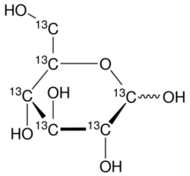
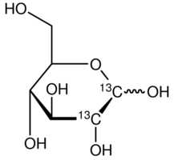
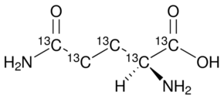
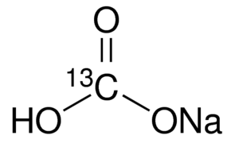
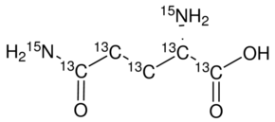
iI. stable-label isotopic substrates
[U-¹³C]-glutamine
[[U-¹³C]-glucose
[1,2-¹³C₂]-glucose
double-label substrate
sodium [¹³C₁]-bicarbonate
for ¹³CO₂ incorporation
[¹³C₅, ¹⁵N₂]-glutamine
Notes:
Stable-isotope labeled compound: Compounds that contain a non-radioactive isotope
Universally labeled substrates, such as [U-¹³C]-glucose and [U-¹³C]-Gln are useful in hypothesis-free isotope tracing experiments that require extensive labeling.
Press the Down Arrow
Positionally labeled substrates, such as [1,2-¹³C₂]-glucose are useful for determining novel metabolic links between pathways originating from glycolysis and PPP pathways.
Press the Down Arrow
Carbon-13 labeled sodium bicarbonate is useful for carboxylase enzyme-based metabolism (e.g., branched chain amino acid catabolism, fatty acid biosynthesis)
Press the Down Arrow
Double-labeled substrates are useful for investigating carbon and nitrogen assimilation.

Slide 10
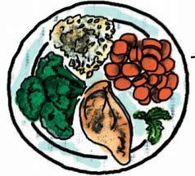


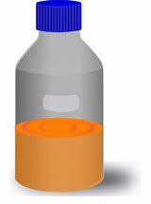


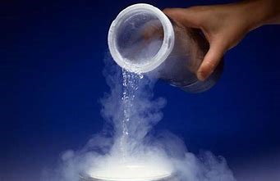
II. Study design
Preparation Phase
+
or
or
+
Initiation Phase (introduction of the labeled substrate)
or
or
Sampling / Quenching Phase
Notes:
Coming up with a rational study design.
Preparation Phase:
Question 1: How will the study subjects be prepared prior to study initiation?
Nutrient Status of subjects: Depleted / Sufficient / Sufficient & Supplemented with vitamins/therapeutics
Press the down arrow
Initiation phase:
Question 2: How will the stable-isotope tracer be administered to the study subjects? Media / food or water / IP – IV bolus – oral gavage
What is the duration of administration?
Press the down arrow
Sampling phase:
Question 3: What are the sampling time points? Technical vs. biological replicates? How will enzymatic quenching be performed, enzymatic inhibitor vs. liquid nitrogen quenching?

Slide 11
Overview
What are Stable-Label Isotope Tracers?
Practical Considerations
How are isotopically labeled compounds measured?
Pertinent MS nomenclature
Commercial mass spectrometers
Low-Resolution vs. High-Resolution, Accurate-Mass instruments
How important is resolution?
Selected Research application
Notes:
Part 3 of this presentation addresses some of the practical design aspects of an isotope tracing experiment.

Slide 12
III. Mass spectrometers
Notes:
The Red section of this graphic illustrates the diversity in the most popular triple-quad mass spectrometers on the market.
Generally, all QqQs have similar performance characteristics such as: i) sensitivity; ii) acquisition speed; and, iii) for the ability to schedule SRM transitions
QqQs are the gold standard instrument platform for targeted bioanalysis, and are useful for relative or absolute quantitation.
QqQs are useful for positional Isotopomer analysis, but the analytical result tables may require a substantial amount of post-processing.
Press the down arrow
The Green Section of the graphic illustrates the diversity of commercially available QToF mass spectrometers.
QToF mass spectrometers are essentially a modified triple-quad, where the second mass analyzing quadrupole is replaced with a field-free time-of-flight tube.
QToFs are useful for i) for targeted or unbiased analysis; ii) for relative or absolute quant; and, iii) may be useful for positional Isotopomer analysis (corrections may still be needed).
QToFs are generally less robust and cost more than the QqQs.
Press the down arrow
The Blue Section of the graphic illustrates several of the thermo scientific OrbiTrap-based mass spectrometers.
Orbitraps are useful: i) for targeted or unbiased analysis; ii) for relative quant; and iii) for measuring stable-isotope labeled atoms with sufficient resolution to discriminate between the neutron labeling of different atomic nuclei (e.g., deuterium and carbon-13 labeling).
Orbitraps may be used for absolute quantitation, but the instrument calibration may suffer from trap filling effects because of the automatic gain control thresholding.
Orbitraps are not useful for positional isotopomer analysis because the lowest scan limit is m/z 50.
These instruments are much less robust than QqQs and are very costly (up to 3x $ of QqQ)

Slide 13
III. Pertinent MS nomenclature
protonated molecular ion
deprotonated molecular ion
LC/Triple-quadrupole MS source and ion path
CID
2,3-C₂H₆N₁
+
2-C₁H₃N₁
+ N₂
Alanine
2,3-C₂H₆N₁
Analyte: alanine; background ions:
Analyte | Precursor Ion (m/z) | Product Ion (m/z) | CE (V) | Fragment
[¹³C₀]-Alanine | 90 | 44 | 6 | 2,3-C₂H₆N₁
[¹³C₀]-Alanine | 90 | 42 | 6 | 2,3-C₂H₄N₁
[¹³C₀]-Alanine | 90 | 29 | 50 | 2-C₁H₃N₁
[¹³C₀]-Alanine | 90 | 27 | 50 | 2,3-C₂H₃
Notes:
As I begin to talk about mass spec instrumentation, there are some pertinent terms and concepts that need to be defined.
Protonated and deprotonated molecular ion – Alanine is zwitterion
Press the down arrow
This figure is a generalized cartoon of QqQ with a typical source and ion optic configuration. And the scan mode being reviewed here is called Selected Reaction Monitoring, or SRM
Press the down arrow (ions and arrow shows up)
Chromatographic effluent from LC, IC, CE, or SFC separations modules may be introduced into the source region of the MS system – analyte is alanine, and the co-eluting compounds are red, green, and blue dots
The ion source performs the following functions:
i) ±kV voltage is applied to the effluent at the tip of the ESI emitter, and the effluent is emitted as small droplets
ii) solvent drop drying yields ionization of dissolved compounds
iii) coulombic repulsion drives the ions from the liquid phase into the vapor phase
iv) a voltage differential accelerates the ions towards the orifice and into the high-vacuum region of the MS system.
Once the ions are inside of the high-vacuum regions, the ion optics perform the following functions:
i.) ions are collimated into a focused beam and are accelerated towards the first mass filtering quadrupole (Q1).
ii) Q1 is tuned so alanine and other isobaric ions have a stable trajectory and are able to translate through the quadrupole field.
iii) Other background ions, with differing m/z ratios, collide with the quadrupoles, their charge is neutralized, and they are removed from the MS by the vacuum.
iv) The alanine ions are accelerated towards the collision cell – a sheathed quadrupole that can be filled with a collision gas such as nitrogen or argon.
Press the down arrow (CID graphic shows up)
In the collision cell, high-energy alanine ions collide with nitrogen, and the collisionally-excited alanine ions break apart into predictable ion fragments – a process known as Collisionally-Induced Disassociation, or CID
The fragment ions are collimated into a beam and are accelerated out of the collision cell towards the second mass filtering quadrupole (Q3).
Press the down arrow (CID graphic disappears)
Q3 is tuned so a specific alanine or other potential isobaric fragment ions have a stable trajectory and translate through the quadrupole field for detection.
Other background ions, with differing m/z ratios, collide with the quadrupoles, their charge is neutralized, and they are removed from the MS by the vacuum.
The scan mode depicted is known as selected Reaction Monitoring, or SRM, and the These Q1 to Q3 ion pairs are known as precursor to product ion transitions.
Press the down arrow for the MS/MS table.

Slide 14
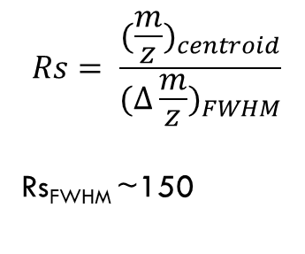
III. Low-Res Q1 scan for Alanine
LR Q1 scan for Alanine
[M+H]⁺ = m/z 90.05*
1 monoisotopic compound
$$Rs= \frac{{(\frac{m}{z})}_{centroid}}{{(∆\frac{m}{z})}_{FWHM}}$$
Rs_{FWHM} ~150
[(M+1)+H]⁺ = m/z 91.05*
∑ Responses of 14 isotope-labeled
alanine compounds
FWHM
[(M+2)+H]⁺ = m/z 92.06*
∑ Response of 93 isotope-labeled alanine compounds
Estimated using chemcalc utility (www.chemcalc.org)
Notes:
The MS spectrum presented here is for a neat solution of Alanine.
These data were acquired using a Q1 precursor ion scan on a Sciex 6500 QTrap system.

Slide 15
III. HRAM-MS MS1 scan for Alanine
Monoisotopic Alanine
Theo: m/z 90.0550
Emp: m/z 90.0548
Mass error: -2.0093 ppm
Rs_{FWHM} ~388,000
[¹³C₂]-Alanine
Theo: m/z 92.0617
Emp: m/z 92.0614
Mass error: -2.3950 ppm
[¹³C₁]-Alanine
Theo: m/z 91.0583
Emp: m/z 91.0581
Mass error: -2.6651 ppm
92.0614
Notes:
The MS spectrum presented here is for the [13C0]-Alanine, PRESS down arrow [13C1]-Alanine, PRESS down arrow and [13C2]-Alanine isotopologs contained in a study sample from a biological isotope tracing experiment.
These data were acquired using a MS-based timed “Single-Ion Monitoring” scan on a Thermo Orbitrap Fusion MS system.

Slide 16

iii. Overlap of isotopically labeled alanine species
n
[(M+2n)+H]⁺Ala =
+ 2
n
= 92.07228 u
[M+H]⁺: 90.05495 u
2 x 1.008665 u
Notes:
What is the mass of a given [(M+2)+H]+Ala species?
Theoretically, one may be tempted to use a simple summation given in the top graphic: $\left[\left(M+2\right)+H\right]+Ala =\left[M+H\right]+Ala$ + 2 x neutron mass = 92.07228u. But, is this simple equation physically relevant?
Press the down arrow
As usual, the physics in this situation is much more complicated.
For example, the mass difference between carbon-13 and carbon-12 isotopes is significantly less than the mass of a “free neutron” by ~ 0.00531 u – this mass difference is known as the mass defect of the nucleus.
The mass defect occurs because some of the mass of all of nucleons contained in the carbon-13 nucleus is converted to energy in order to bind the new neutron – this energy is known as the nuclear binding energy, and in this instance is equivalent to 4.91 MeV.
The table of lists the differential masses for the different [(M+2)+H]⁺Alanine species based on their mass defects.
These data are are reported in ppm, and any difference < 10 ppm is designated in red as potentially isobaric isotope-labeled species that may interfere with the quantitation of another species.
Press the down arrow
This table shows how effective instrument resolving power is at resolving these potential isobaric species.
Press the down arrow
These phenomena are described by the theory of special relativity, and Einstein’s famous equation, E=mc2, which is used to calculate the nuclear binding energy for nuclear reactions.

Slide 17
Overview
What are Stable-Label Isotope Tracers?
Practical Considerations
How are isotopically labeled compounds measured?
Selected Research application
Collaboration
Background experiments
Experimental Design
LR-MS/MS Positional Isotopomer Measurements
LC-HRAM-MS Isotopolog Measurements
Notes:
Part 4 of this presentation illustrates the use of these techniques in biological application.

Slide 18


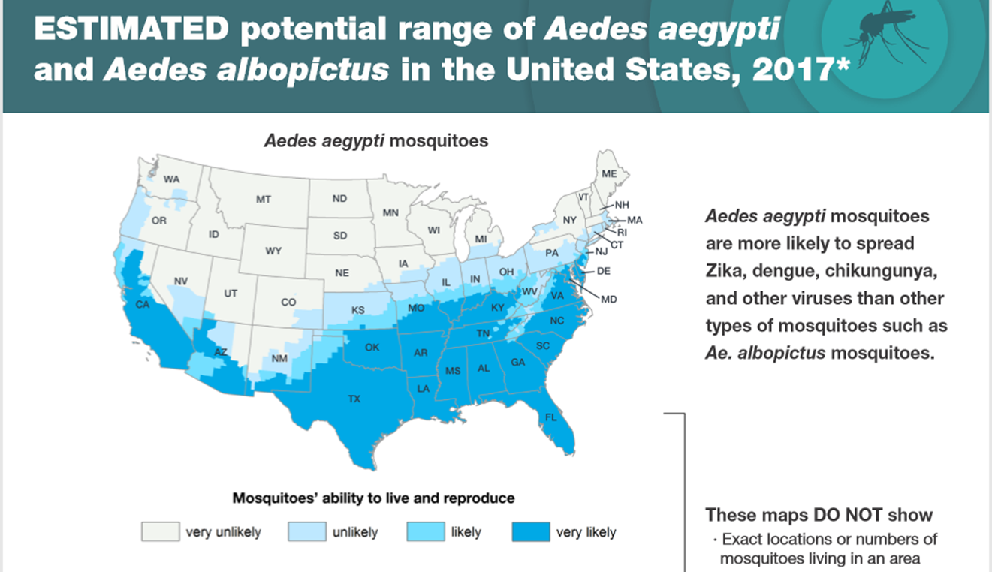
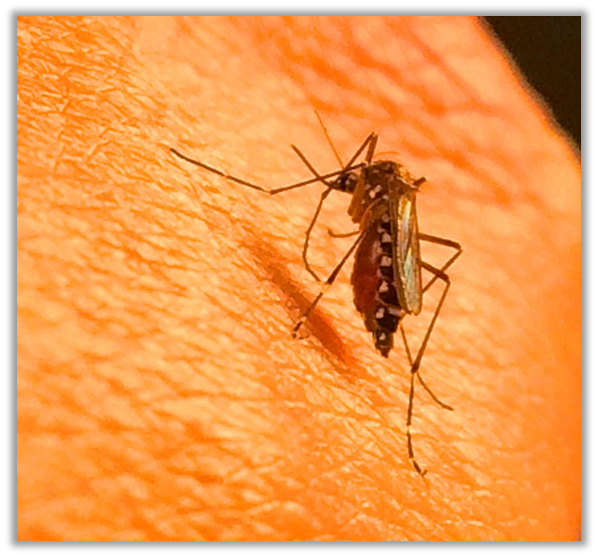
Iv. Collaboration with Patricia Scaraffia

Slide 19
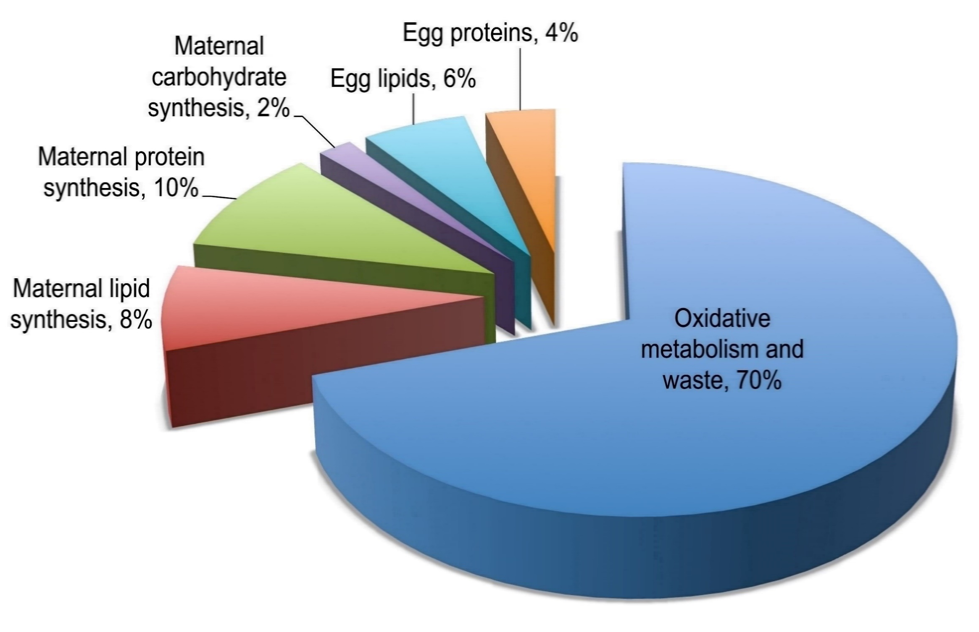
IV. Proteogenic Amino Acid Utilization in Blood-fed A. aegypti Mosquitoes
NH₃
Petchampai and Scaraffia, 2016. New insights into the nitrogen metabolism in blood-fed mosquitoes. In: Raikhel AS ZN (Ed). Advances in Insect Physiology - Progress in Mosquito Research. Elsevier Academic Press Inc., USA, (2016)

Slide 20
IV. Ammonia metabolism in A. aegypti
Scaraffia et al. Insect Biochem Mol Biol. 36:614-622, 2006 ; Scaraffia et al. PNAS. 105:518-523, 2008; Scaraffia et al. J. Insect Physiol. 56:1040-1049, 2010

Slide 21
IV. Scope of this Research Study
Hypothesis for this study:
The carbon skeleton of glucose, obtained from the diet or from maternal reserves, supplies the keto acids necessary for the synthesis of amino acids and other nitrogen-containing compounds during ammonia clearance in blood-fed mosquitoes.

Slide 22
IV. Study Design
Preparation Phase:
Female mosquitoes were fed a 3% sucrose solution for 3 d, and then starved for 1 d
Initiation Phase:
5 d old mosquitoes were split into 3 cohorts, and fed the following research diets for 15 minutes:
Control group 1:
Bovine blood + 5 mM ATP (BM)
Control group 2:
BM + 100 mM glucose
Study group:
BM + 100 mM [1,2-¹³C₂]-glucose
Sampling Phase:
Time points: 0, 0.25, 1, 6, 12 and 24 h after feeding
5 mosquitoes whole bodies per timepoint sample per cohort
The study was performed in triplicate

Slide 23

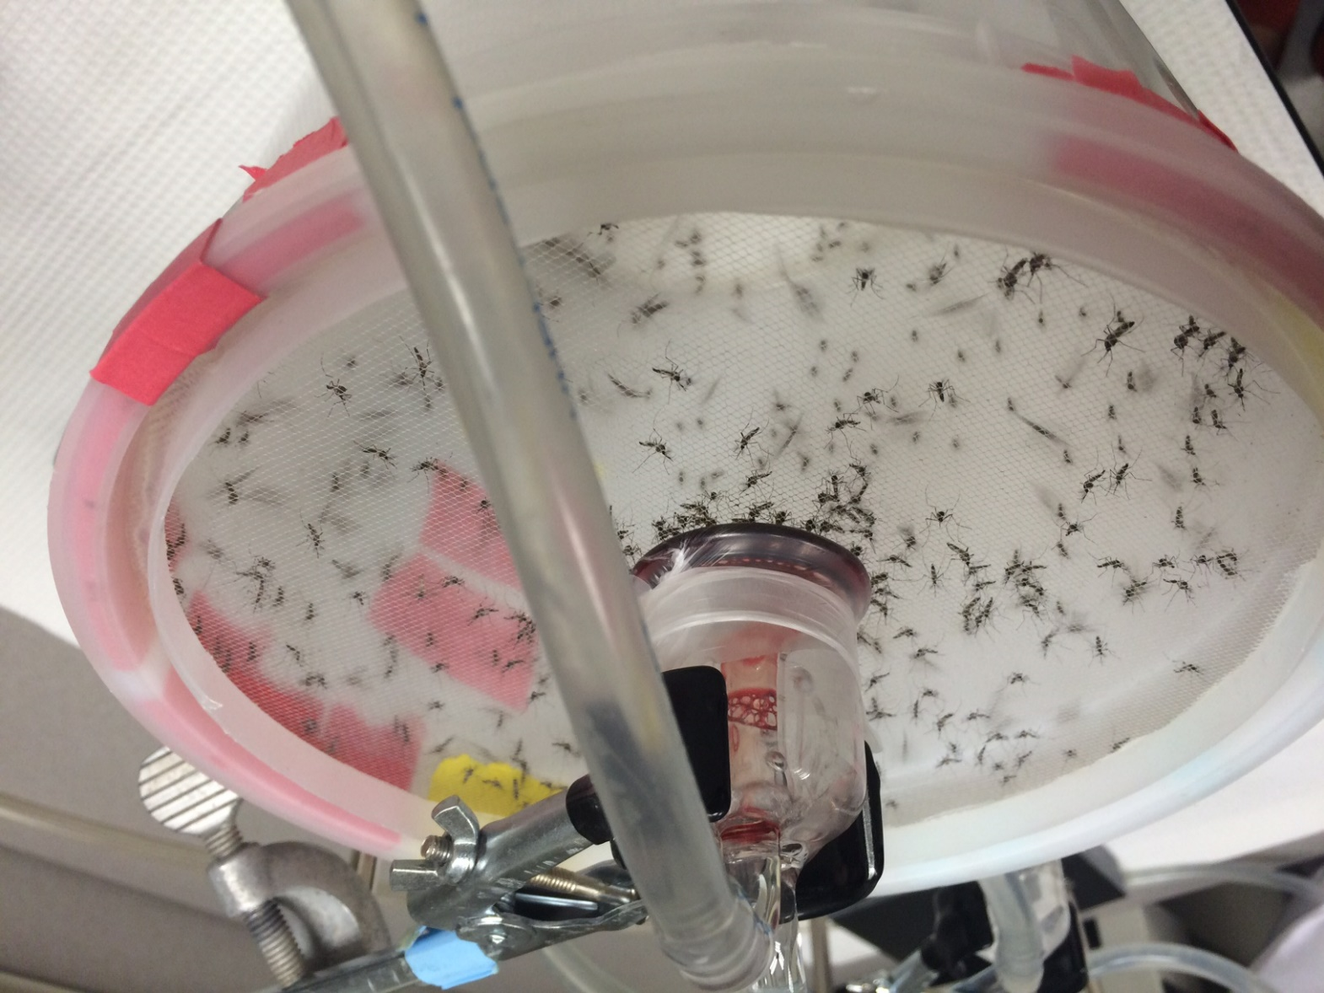
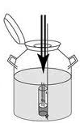



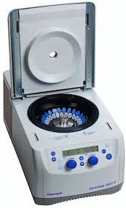

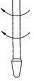
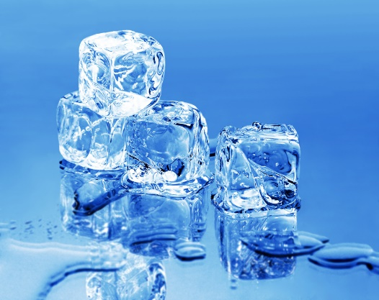
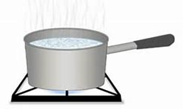
IV. Feeding & Quench Procedure
Mosquitoes are fed for 15 min
3 groups
LN₂ quench
Extraction Procedure
500 µL water
homogenized
2 min
14,000g, 10 min, 2x
-80°C

Slide 24
LC-LR-MS/MS - based Positional Isotopomer Measurements
Notes:
Over the next few slides, I will discuss the Low-Resolution positional isotopomer data sets for Alanine acquired from the mosquitoes fed [1,2-13C2]-glucose.
I will also discuss the correction algorithms that we developed to correct the experimental data for the existence of the complex background of isotope-labeled species.
These data were acquired on an Agilent 6460 QqQ MS system.

Slide 25
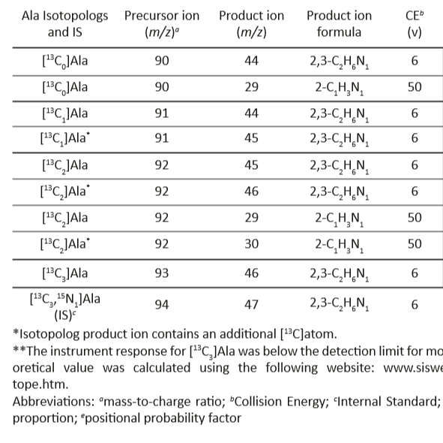
iV. Ala Fragmentation patterns with Correction parameters
Ma, X., Dagan, S., Somogyi, A., Wysocki, V.H., Scaraffia, P.Y., Low Mass MS/MS Fragments of Protonated Amino Acids used for Distinction of their 13C-Isotopomers in Metabolic Studies., J. Am. Soc. Mass Spectrom., 2013, 24(4):622-631.
Notes:
Here is a table of the “Precursor-to-Product Ion” transitions that Professor Scaraffia developed in the reference listed below

Slide 26
iv. Scheduled SRM chromatogram on the Agilent Triple quad MS
Horvath, et al., FASEB J., 2018, 32(1):466-477
Notes:
The chromatogram here was obtained using a Supelco Ascentis Express HILIC column (150 x 2.1) and typical HILIC mobile phases.
A dynamic scheduled-MRM (dMRM) scan mode was utilized on the Agilent 6460 MS system, and the number of transitions monitored for each metabolite, the RTs of interest, and the dMRM window are all specified in the inset.

Slide 27
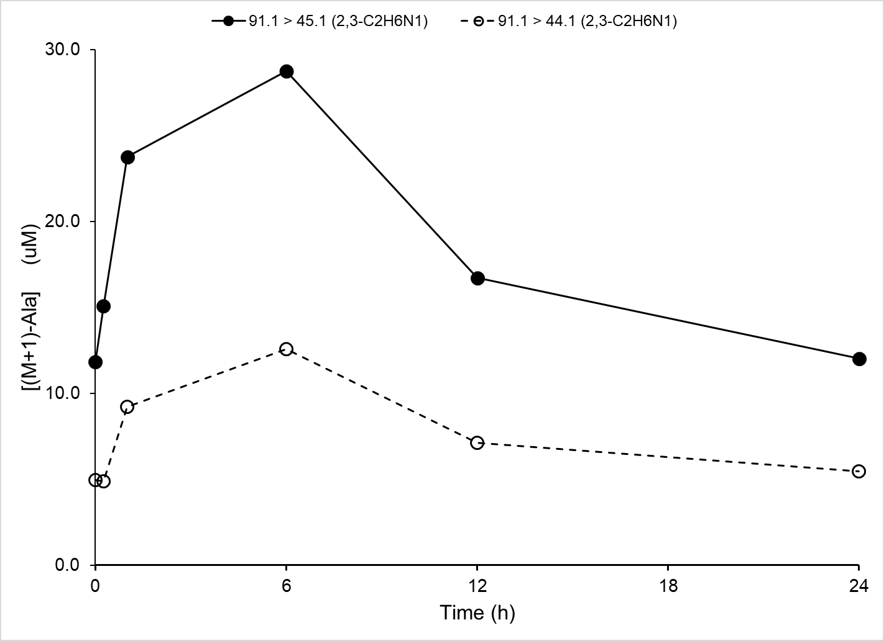
iv. Plots of [(M+1)-Ala] vs. Time
[(M+1)-Ala] = {[[¹³C₁]-ALA] + [(M+1)-Ala]_{Background}}
Notes:
The plot of the [(M+1)-Ala] versus time (h) data did require positional isotopomeric corrections because of the presence of isotopically-labeled background species in the samples.
The [(M+1)-Ala] contribution from the stable-labeled Internal standard [¹³C₅, ¹⁵N₁]-Ala was < 0.02% of the lowest measured concentration in a biological sample – no ISTD correction was required.

Slide 28
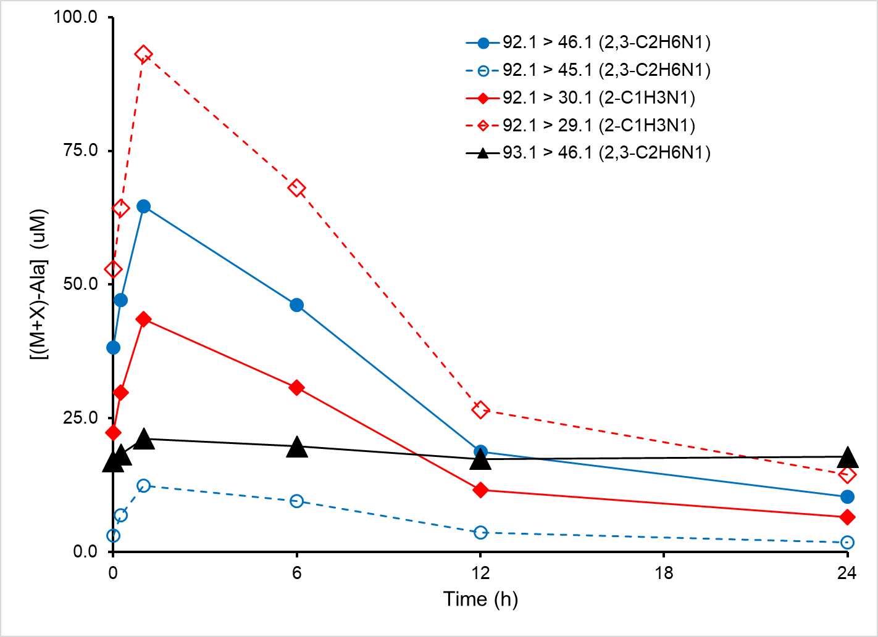
iv. Plots of [(M+2)-Ala] & [(M+3)-Ala] vs. Time
Notes:
The plot of the [(M+2)-Ala] and [(M+3)-Ala] versus time (h) data did required the same positional isotopomeric corrections.
The [(M+2)-Ala] contribution from the IS was < 0.2% of the lowest measured concentration in a biological sample – no ISTD correction was required.
The [(M+3)-Ala] contribution from the stable-labeled internal standard was equal to 100% of the lowest biological sample, so an ISTD was required.

Slide 29
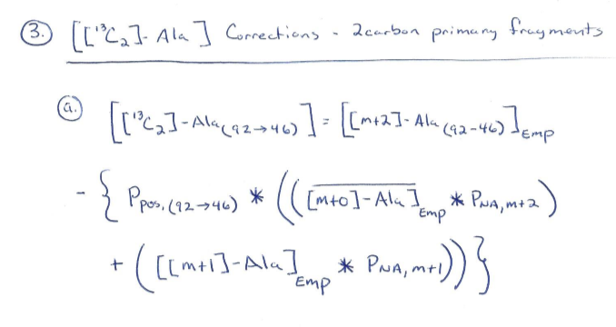
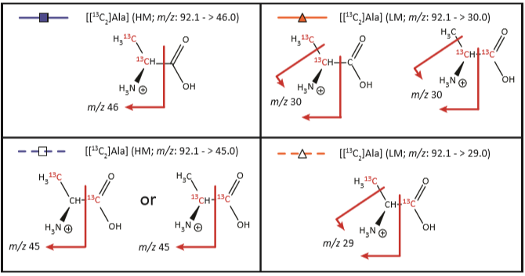
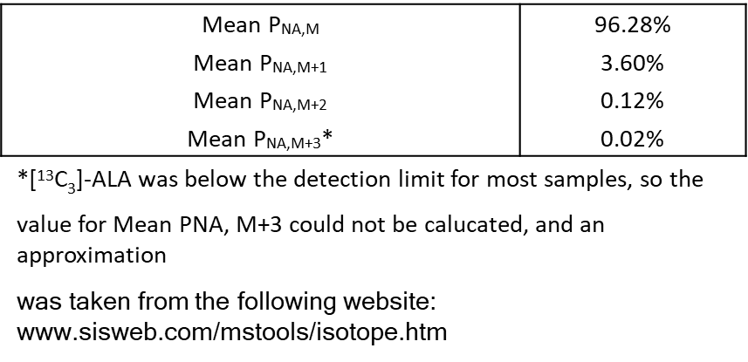
iV. [¹³C₂]-Ala correction algorithm
Notes:
Several attempts were made at correction the study group data (mosquitoes fed BM + 100 mM [1,2-¹³C₂]-glucose) using the control group sample set (mosquitoes fed BM + 100 mM glucose).
We quickly realized that this approach would not work because of the extremely complex isotopically-labeled background present in the study samples – the bovine BM that was enriched with 100 mM [1,2-¹³C₂]-glucose also contained a high level of unlabeled glucose.
so we figured out a method for estimating the isotope labeled background within the study samples, and subtracted that off of the measured concentration.
See the hand-written equation above –
Press the Down arrow before and after
the red boxes refer to empirically determined concentrations measured from the mosquito study samples.
Press the Down arrow before and after
The green boxes refer to empirically determined P_{NA} of N=0, 1, or 2 background isotope labels occurring in the background.
Press the Down arrow before and after
The blue box refers to the positional probability of these isotope labels occurring on the fragment ion or the neutral loss – this probability eliminates the double counting of the background correction.
Press the Down Arrow
The structure in box on the lower left hand side of the slide shows the fragment ion for the Precursor-to-Product Ion Transition specified for [2,3-¹³C₂]Alanine. The fragmentation pattern of a molecule is used to calculate positional probability for how atoms partition between the fragment ion and neutral loss – in this case, Ppos = 0.666.
Press the Down Arrow
The table on the right-hand side of the slide shows the empirically determined PNA terms for each isotope labeled species from the mosquito control samples

Slide 30
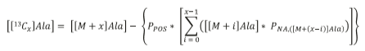
iV. Generic Correction algorithm
Horvath, TD. (May, 2017). A targeted metabolomic workflow for the determination of positional isotopomer distributions of labeled metabolites in stable isotope tracer studies, Poster session presented at the 2017 Cancer Metabolism Symposia, The University of Texas MD Anderson Cancer Center, DOI:10.13140/RG.2.2.22660.83847
Notes:
After reviewing the correction algorithms for all of the isotopologs for Alanine, Proline, Glutamine, and Glutamate, I realized that the correction algorithm collapsed into a general equation that worked in all instances. The general equation is shown on this slide.

Slide 31
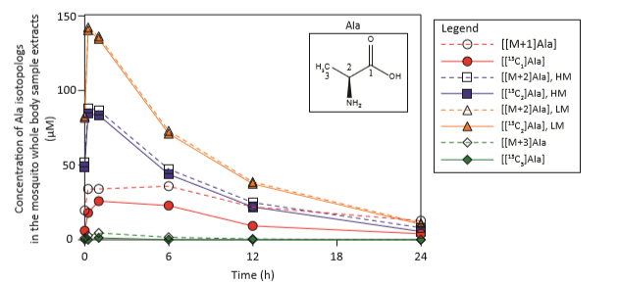
iv. Application of the correction algorithm to empirical data
Horvath, TD. (May, 2017). A targeted metabolomic workflow for the determination of positional isotopomer distributions of labeled metabolites in stable isotope tracer studies, Poster session presented at the 2017 Cancer Metabolism Symposia, The University of Texas MD Anderson Cancer Center, DOI:10.13140/RG.2.2.22660.83847
Notes:
This plot shows the extent of the correction algorithm on the empirical Alanine data.
As expected, there is a large effect on [[13C1]Ala] data (large NA background), and on the [[13C3]Ala] data (large contribution from the internal standard).
As expected, the corrections for the [[13C2]Ala] high-mass and low-mass data were minimal

Slide 32
LC-HRAM-MS/MS - based Isotopolog Population Measurements
Notes:
Over the next few slides, I will discuss the High-Resolution, Accurate-Mass isotopolog population data sets acquired from the mosquitoes fed [1,2-13C2]-glucose for a host of metabolites.
These data were acquired using an orbitrap fusion mass spectrometer.

Slide 33
IV. Targeted Metabolomic Methods
Method for Amino acids
36 metabolites & 20 IS compounds
Imtakt Intrada Amino Acid column
Ion exchange chromatography
235 potential carbon-13 isotopologs
Method for Organic Acids:
6 metabolites & 5 IS compounds
ZIC-pHILIC column
HILIC chromatography
36 potential carbon-13 isotopologs
Horvath, et al., FASEB J., 2018, 32(1):466-477

Slide 34
IV. Metabolites Measured
Amino acid and amino acid derivative metabolites | Retention Time (min) | Amino acid and amino acid derivative metabolites | Retention Time (min) | Amino acid and amino acid derivative metabolites | Retention Time (min)
Pyroglutamic acid | 2.1 | Methionine Sulfone | 8.1 | Serine | 12.5
Phenylalanine | 4.8 | Sarcosine | 8.6 | Asparagine | 13.0
Kynurenine | 4.9 | Acetylcholine | 8.7 | S-Adenosyl-Homocysteine | 13.0
Tryptophan | 4.9 | 4-Hydroxyproline | 9.1 | Citrulline | 15.0
Leucine / Isoleucine | 5.4 / 5.9 | Alanine | 10.0 | GABA | 17.1
Methionine | 6.1 | Threonine | 10.3 | Cystine | 23.6
Tyrosine | 6.3 | Hypotaurine | 10.4 | Histidine | 32.2
Proline | 6.8 | Glutathione, reduced | 11.0 | Lysine | 33.2
Valine | 7.0 | Creatine | 11.2 | Ornithine | 33.3
Creatinine | 7.2 | Glycine | 11.7 | Arginine | 36.3
Taurine | 7.2 | Methionine Sulfoxide | 12.0
Cysteine | 8.0 | Glutamine | 12.4
Organic Acid Metabolites | Retention Time (min)
Pyruvic acid | 3.9
Lactic acid | 6.5
Uric acid | 10.4
Glutamic acid | 13.2
α-Ketoglutaric acid | 13.9
2-hydroxyglutaric acid | 14.1
Amino acid “Nitrogen Sinks”
Keto acids of interest

Slide 35
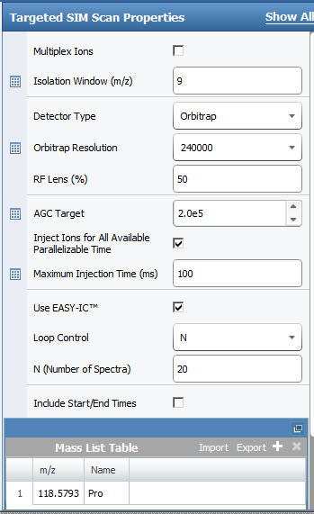
IV. tSIM Scan Window Selection
Xcalibur software tricks:
Define the range of the isotopolog distribution.
Compute the mid-point, and enter into the software
Extend the isolation window ± 2 m/z units beyond the isotopolog range to limit quadrupole isolation edge effects.
Midpoint of Proline isotopolog distribution:
[¹³C₀]-Pro: [M+H]⁺ = m/z 116.07061
[¹³C₅]-Pro: [M+H]⁺ = m/z 121.08738
Midpoint: m/z 118.5793
Isolation window (m/z): 2 + 5 + 2 = 9
Notes:
Here is an example of the timed SIM acquisition method used for acquiring Proline isotopolog population data.

Slide 36
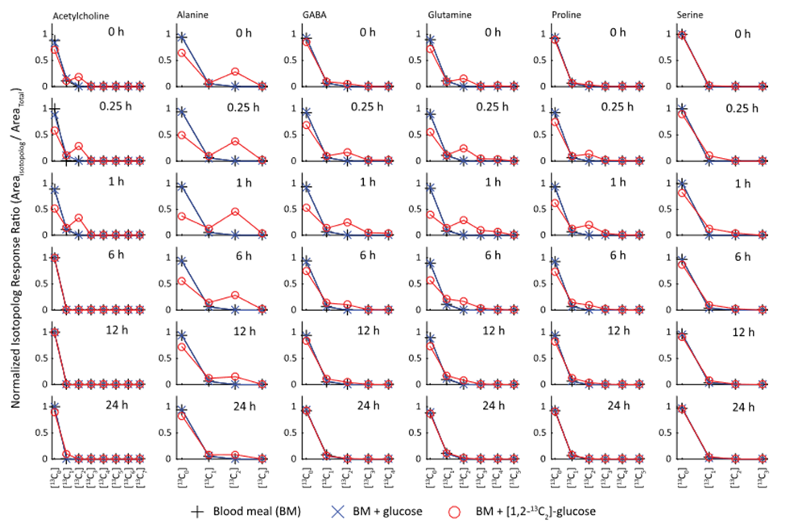
VI. Experimental Results for Amino Acids and derivatives
Horvath, et al., FASEB J., 2018, 32(1):466-477
Notes:
The following is a short description on how to make sense of these isotopolog population data sets for a given time point
Press the Down arrow before and after
The red ellipse at the top of the page shows the name of the metabolite corresponding to the series of time course plots
Press the Down arrow before and after
The green circles shows the location of the timepoint designation
Press the Down arrow before and after
The yellow box shows the y-axis title for all of the individual plots on the slide – the y-axis is the normalized isotopolog response ratio
Press the Down arrow before and after
The blue box shows all of the isotopologs for a given metabolite (in the example, the metabolite is acetylcholine, and they range from [13C0]- to the fully carbon-13 labeled Isotopolog for a given metabolite.
Press the Down arrow before and after
The purple box at the bottom shows the same legend; BM mosquito control is designated by the black plus sign and line; BM + glucose control is designated by the blue X and line; The study samples are designated by the red circle and line.
Press the Down arrow before and after
Enrichment of an isotope-labeled metabolite is evident when the red circle and line is deflected away from the control samples -

Slide 37
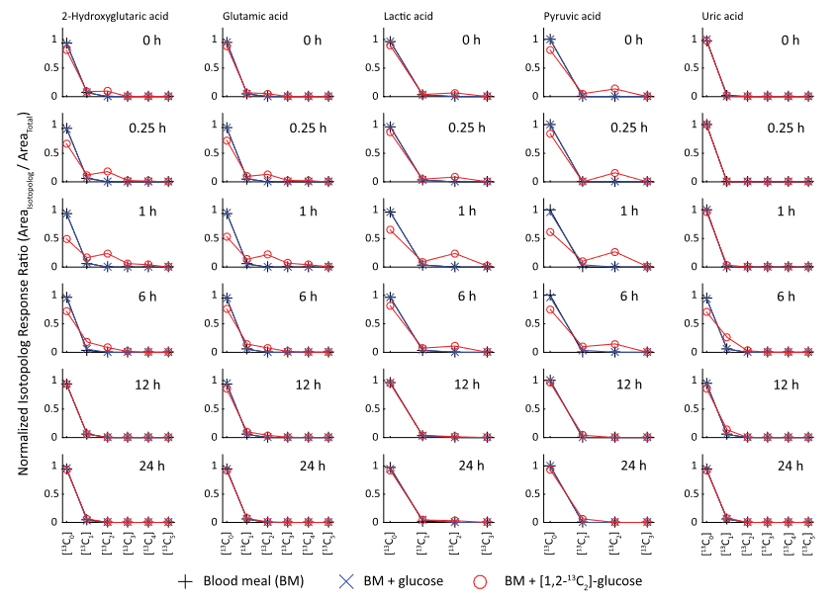
VI. Experimental Results for Organic Acids
Horvath, et al., FASEB J., 2018, 32(1):466-477

Slide 38
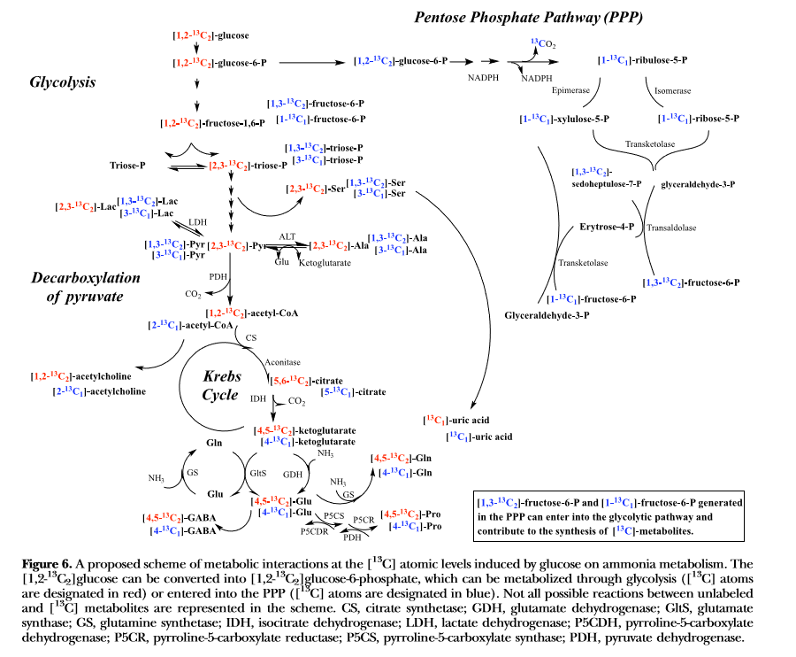
V. Metabolic Map of pathways in the A. Aegypti mosquito
Horvath, et al., FASEB J., 2018, 32(1):466-477
Notes:
Press the down arrow before and after
Here is the metabolic map generated by Professor Scaraffia, and for the first time these data link keto-acids produced from the carbon-backbone of glucose with the production of amino acids, Alanine, Proline, Glutamine, and Glutamate in the blood-fed mosquito.
It is thought that these amino acids act as Nitrogen Sinks responsible for the assimilation and detoxification of the high levels of ammonia produced during proteogenic amino acid catabolism in the blood-fed mosquito.
Press the down arrow before and after
Additionally these data show for the first time, the link between glucose metabolism and the production of uric acid, which may be one of the main routes of nitrogen elimination in the blood-fed mosquito.
These data may provide the reason why female mosquitoes will sometimes drink nectar prior to taking a blood meal.

Slide 39
Conclusions
Hopefully, a sufficient level of background information has been provided so that an attendee may begin to think about the rational design of an isotope tracing experiment.
A LR LC-MS/MS-based method for determining the position of carbon-13 isotope incorporation into a metabolite of interest has been presented – with a ton of work, this method may be extended to other isotope labels or metabolites.
An HRAM LC-MS-based method for performing isotopolog population studies has been presented – this method may be extended to other metabolites by substituting alternate chromatographic systems.

Slide 40



acknowledgements
Lin Tan
Leona Martin
Dr. Di Du (Exxon Mobil)
Michael Pontikos (MD/PHD student UTSW)
Dr. David Hawke
Dr. Phil Lorenzi
Dr. John Weinstein
Dr. Patricia Scaraffia
Dr. Shai Dagan
MD Anderson CC Funding:
CPRIT Grant #: RP130397
MDA NCI grant #: CA016672
Tulane Funding:
NIH Grant (R01 AI088092)
Corine Adams Baines Professorship
COR Fellowship
VBIDRC Pilot Grant
Carol Lavin Bernick Faculty Grants

Slide 41
Questions

